Slide 1
Technology at
Hopkinton High School
Sam Dowd
Technology Integration Specialist

Slide 2

3 Computer Labs
20 iMacs each
  Loaded with dozens of educational applications
Each Lab has a projector with a laptop and VGA cable to hook up your laptop
There is a SMARTBoard lab A218
All computers are hooked up to the printers in the building
Clip art

Slide 3

2 MacBook Carts
25 laptops in each cart
  Contains all of the same applications that are on the teacher laptops
Students can log in with their network credentials
Printing is enabled for all of the printers and copiers in the building
Wireless access is available throughout the school

Slide 4
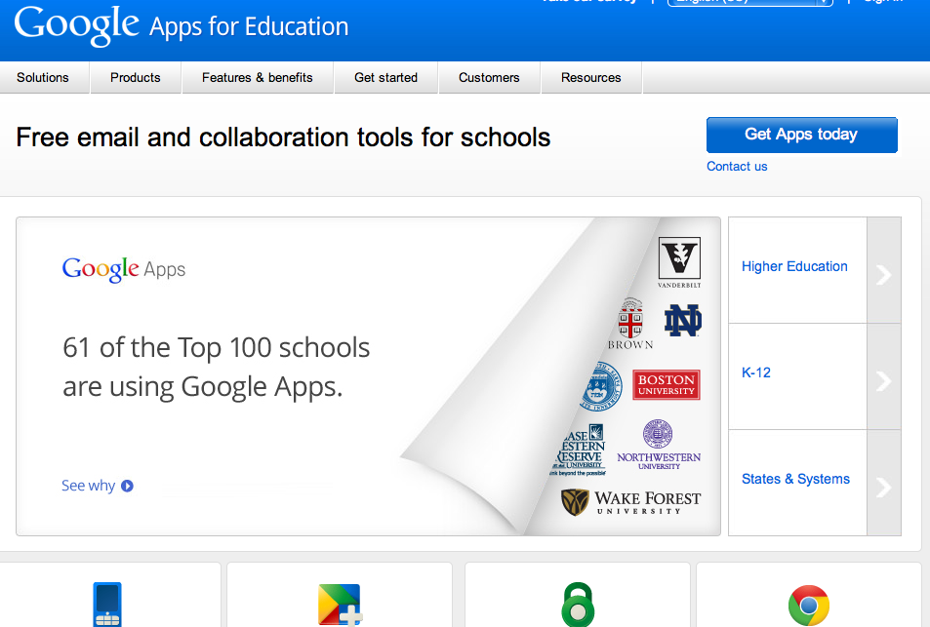
Google Apps
All building users have access to their Google account
  Gmail
  Google Calendar
  Google Docs
  Much more
The Integration Specialist is available to train individual users, departments, and classes on how to use these tools
Full and exclusive use of Google tools is encouraged
Something new- Insert Screenshot

Slide 5
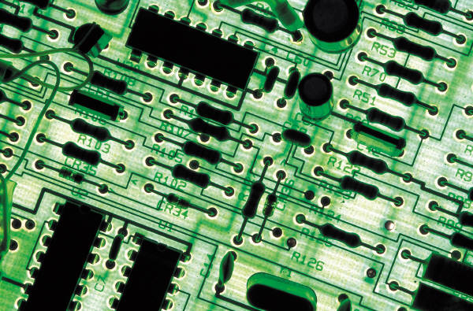
iPad Cart
An iPad cart as well as individual iPads are available to be signed out of the library
30 iPads
Managed by one MacBook that is included with the cart
Acts as a syncing station as well as a charging station for all 30 iPads

Slide 6
Questions?
Name | Title | Email
Ryan Blanchard | Technician | rblanchard@hopkinton.k12.ma.us
Linda Henderson | Data Administrator | Lhenderson@hopkinton.k12.ma.us
Sam Dowd | Technology Integration Specialist | sdowd@hopkinton.k12.ma.us

